Slide 1
PROJECT TITLE - IBM Watson Book Recommendation Chatbot
Developed By - Ms. Shailja Pandey
Supervisor - Ms. Naina Devi

Slide 2
INTRODUCTION-
This project is a smart, conversational chatbot built using IBM Watson Assistant (Lite Plan).
It helps users find book suggestions based on mood, genre, author, or reading duration (short/long reads).
The chatbot is deployed using GitHub Pages and has a simple web interface.

Slide 3
PROBLEM STATEMENT-
Many readers struggle to select the right book that suits their current interest, mood, or available time.
Existing platforms offer fixed recommendations, not interactive ones. The need is for a friendly, chat-based system that adapts to user preferences.

Slide 4
OBJECTIVES-
Create a chatbot that can recommend books in a human-like conversation
Use IBM Watson Assistant for NLP-based dialogue
Enable options like mood, genre, and author-based recommendations
Deploy the chatbot online for easy access

Slide 5
TECHNOLOGY STACK -
IBM Watson Assistant (Lite) – Dialog node design
HTML/CSS – Frontend chatbot interface
GitHub – Code version control and hosting
GitHub Pages – Deploy the chatbot to the web
Google Slides & Drive – Project documentation and sharing

Slide 6
SYSTEM ARCHITECHURE -
User → Chat Interface (index.html) → IBM Watson Dialog Nodes → Response → Book Suggestion
Intents & Entities handle user input
Dialog Nodes decide the response path
HTML page connects the chatbot to the web

Slide 7
MODULE AND FEATURES-
Welcome Node Greets user, sets context, redirects to main menu Main Menu Book suggestions + options: • Mood-based • Genre-based • Author-based • Short/Long Reads • Similar Books • Suggest Another Fallback Node Handles unrecognized input, asks user to rephrase Intent Triggers Quick access via intents like #short_read, #recommend_genre, etc.

Slide 8
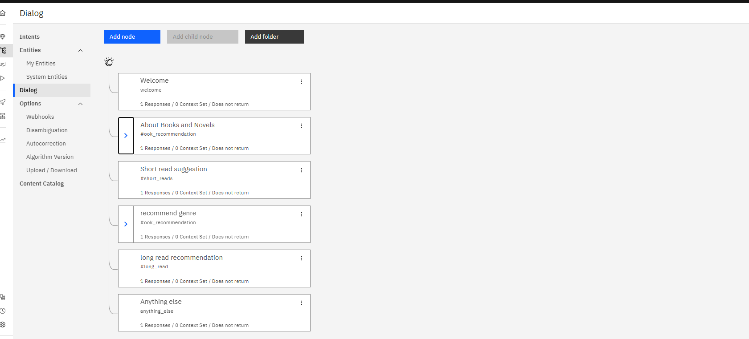
IMPLEMENTATION SCREENSHOTS-
(DIALOG EDITOR)

Slide 9
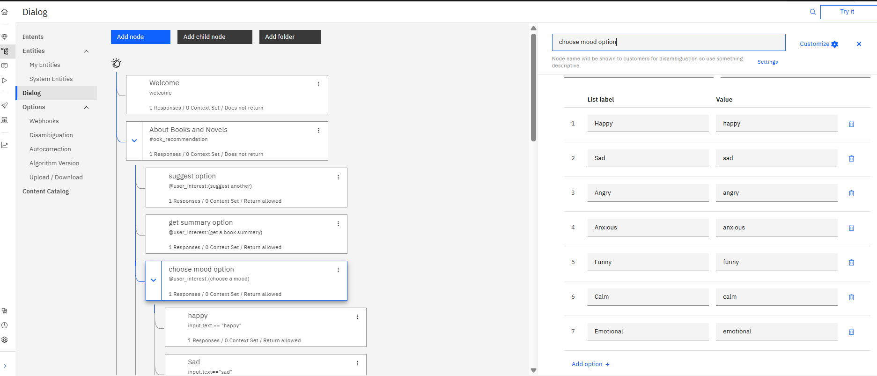
BOOK SUGGESTION MENU-

Slide 10
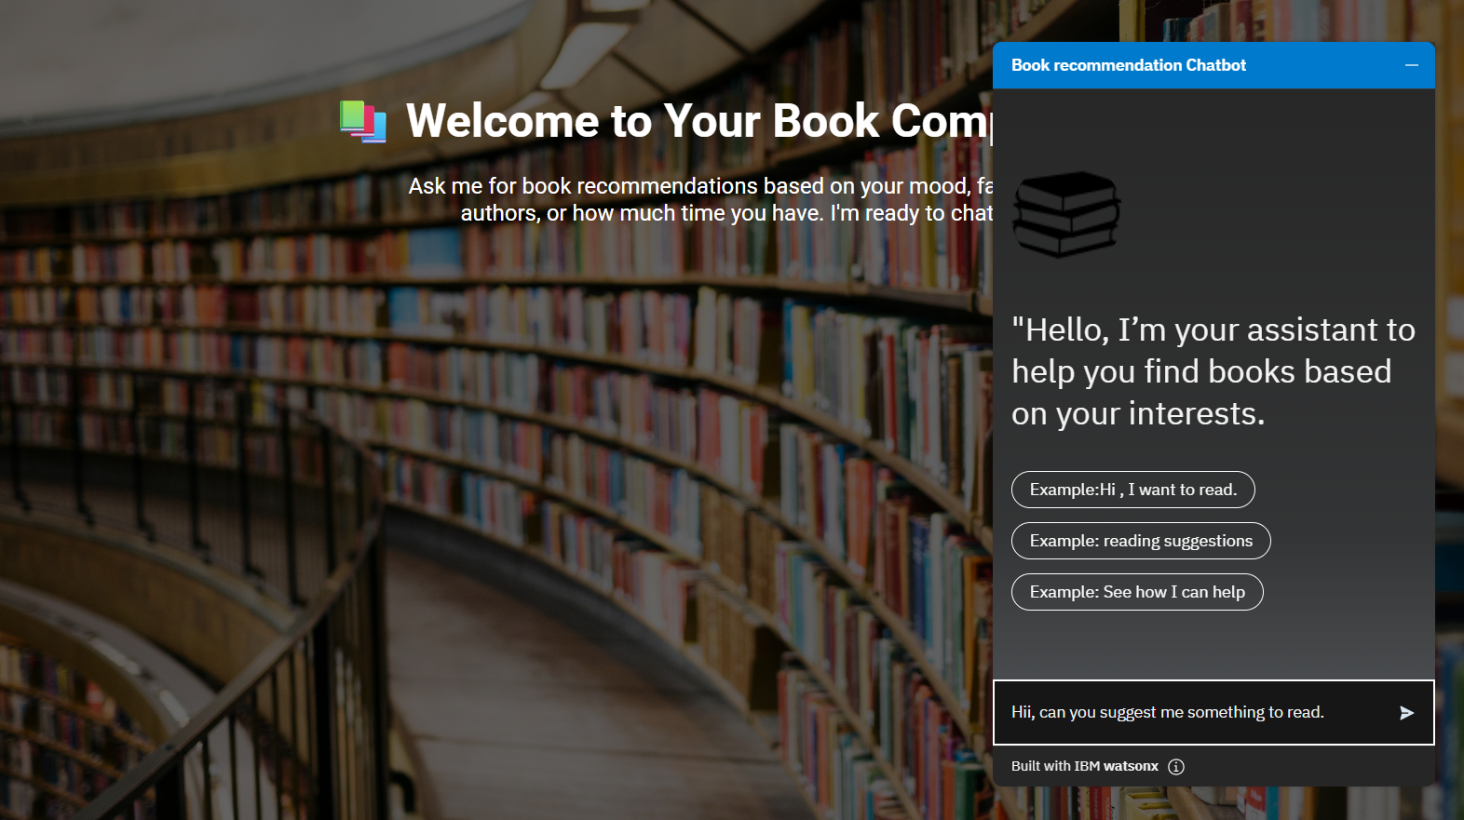
CHAT-BOT INTERACTION WITH USER-

Slide 11
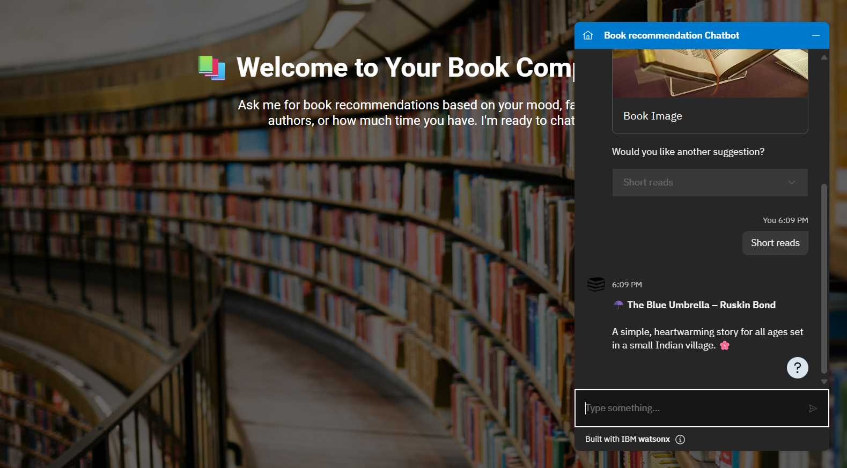
INTERACTION WITH THE USER REQUEST-

Slide 12
RESULT AND ANALYSIS-
Chatbot successfully suggests books based on user input
Options like author, genre, and mood are fully functional
The fallback node handles unexpected input
Successfully deployed online via GitHub Pages

Slide 13
CHALLENGES FACED-
Designing smooth and logical dialog flow
Managing multiple entities and intents without conflict
Connecting Watson Assistant to an HTML interface
GitHub Pages configuration for chatbot hosting

Slide 14
CONCLUSION AND FUTURE WORK-
Conclusion:
The chatbot simplifies book discovery using a conversational interface. It supports multiple input types and provides rich suggestions.
Future Work:
Add real-time book APIs (Google Books, Goodreads)
Enable user personalization and login
Add voice support using speech-to-text
Track reading history or favorites

Slide 15
THANKYOU
Shailja Pandey
(Btech - CS AIML) 4th Sem.
United College of Engineering and Research.
Naini, Prayagraj.

